Slide 1
Gradle and java 11

Slide 2
Gradle
Introduction
Feature & performance
Migrate mvn to gradle
Demo 2 project monolithic and multi modules
JAVA 11

Slide 3

Introduction
Gradle is an open-source build automation tool that is designed to be flexible enough to build almost any type of software

Slide 4
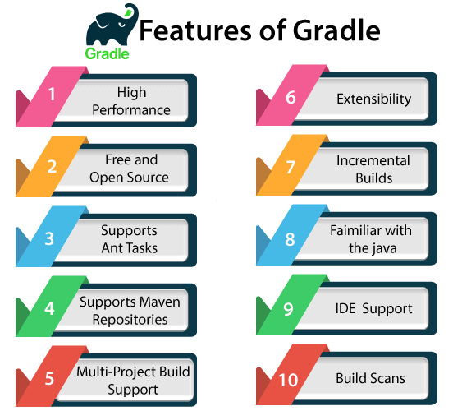
Features

Slide 5
Features
High performance: Gradle quickly completes the task by reusing the output from the previous execution. It processes tasks whose only input is changed and executes the task in parallel. Thus it avoids unnecessary tasks and provides faster performance.
Extensibility: Extensibility is one of the decent features of Gradle. We can easily extend the Gradle to provide our task types or build models. For an example of this, see Android Build Support: It adds several new build concepts such as flavor and builds types.
Build scan: The Build Scans provides comprehensive information about build run that can be used to identify build issues. They also help us to diagnose the problems with a build's performance. The build scans can be shared with others; this can be useful if we need the advice to fix an issue with the build.

Slide 6
Performance
Link: https://gradle.org/maven-vs-gradle/
Flexibility: Google chose Gradle as the official build tool for Android; because Gradle is modeled in a way that is extensible in the most fundamental ways. Gradle's model also allows it to be used for native development with C/C++ and can be expanded to cover any ecosystem.
Performance
Incrementality: only processing files that changed when possible.
Build Cache: Reuses the build outputs of any other Gradle build with the same inputs, including between machines.
Gradle Daemon : A long-lived process that keeps build information "hot" in memory.

Slide 7
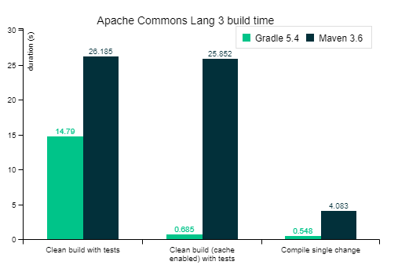
Performmance (2)
These and more performance features make Gradle at least twice as fast for nearly every scenario (100x faster for large builds using the build cache) in this Gradle vs Maven performance comparison.

Slide 8
Migrating Builds From Apache Maven
Create a build scan for the Maven build
Verify that the two builds produce the same artifact
Run an automatic conversion
Create a build scan for the gradle build
Verify your dependencies and fix any problems
Configure integration and functional tests
Replace maven plugins with gradle equivalents

Slide 9
Create a build scan for the Maven build
Visualize what’s happening in your existing Maven build
See the project structure, what plugins are being used, a timeline of the build steps, and more.
Compare it to the Gradle build scans
Create maven build scan
Declare the gradle enterprise maven extension in .mvn/extensions.xml
Mvn install publishing build scans to scans.gradle.com

Slide 10
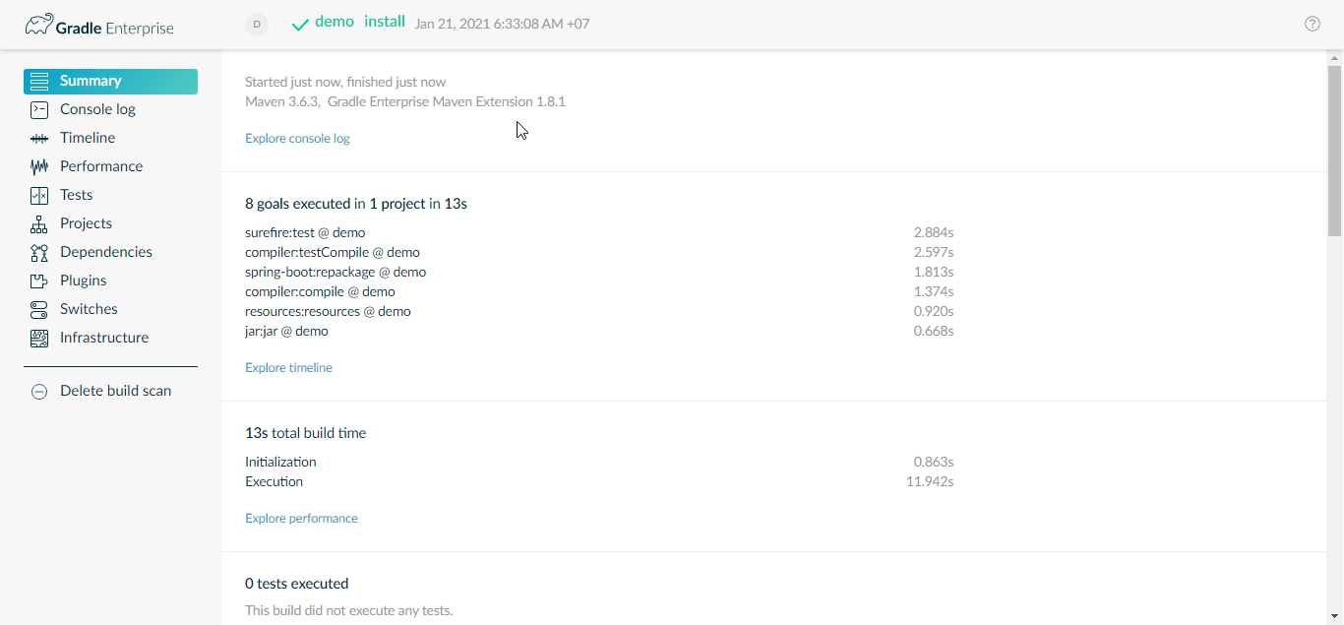
Maven build scan demo

Slide 11
Verify that the two builds produce the same artifact
This is a step to ensure that your deployments and tests don’t break
If Gradle build produces the same output as the Maven build, this will you confidence in switching over
Don’t need to verify every artifac at every stage. We can just focus on the critical output such as final reports and the artifacs that are published or deployed

Slide 12
Run an automatic conversion
Command: gradle init
This convert an existing Maven build to Gradle automatically, even for multi-module builds.
New Gradle build includes:
All the custom repositories that are specified in the POM
External and inter-project dependencies
The appropriate plugins to build the project (limit to Maven Publish, Java and War Plugins)
Some manual work:
Using the Distribution Plugin
Using the Java Library Distribution Plugin
Using the Application Plugin
Creating custom archive tasks
Using a suitable community plugin from the Gradle plugin Portal

Slide 13
Create a build scan for the Gradle build
Visualize what’s happening in the build. See the project structure, the dependencies (regular and inter-project ones), what plugins are being used and console output of the build
Build may fail, but the scan will still run. Compare the build scan for the Gradle build to the Maven build to troubleshoot the failures.
A Gradle build scan can improve the performance of the build
Command: gradle build –scan. Publishing build scans to scan.gradle.com.

Slide 14
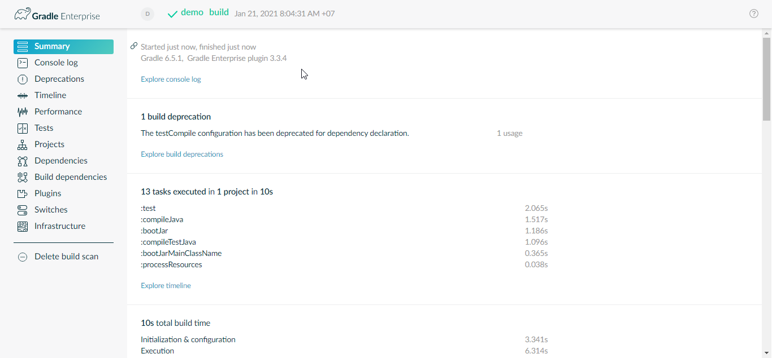
Gradle build scan demo

Slide 15
Verify your dependencies and fix any problems
Gradle supports the same concepts of repositories, declared dependencies, scopes (dependency configurations in Gradle), and transitive dependencies
One difference between the two tools is how they manager version conflicts. Maven use a “closet” match algorithm, whereas Gradle picks the newest.

Slide 16
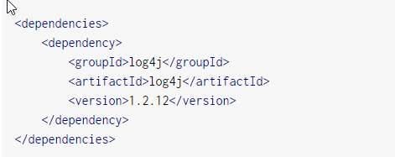
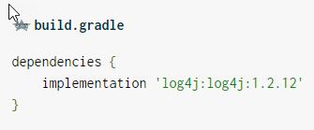
Declaring dependencies
Dependency identifier components in Maven: groupId, artifactId and version. Gradle refers to them as group, module and version.
dependencies {
implementation group: ‘log4j’, name: ‘log4j’, version: ‘1.2.12’
}

Slide 17
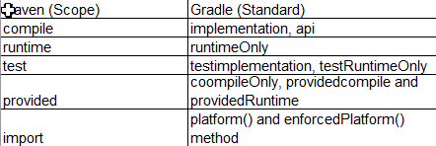
Scopes vs Standand configurations
Gradle distinguishing between the dependencies required to build a module and the dependencies required to be available at runtime.
Maven makes no such distinction, so POMs include dependencies that consumers of a library don’t actually need.

Slide 18
Controlling dependency version
Gradle pick the newest version of a dependency in the graph, but that’s not always the right solution
Serveral mechanisms for controlling dependency version
Dependency constraints
Bills of materials (Maven BOMs)
Overriding transitive versions
Excluding transitive dependencies
Handling optional dependencies

Slide 19
Configure integration an function tests
Many tests can simple be migrated by configuring an extra source set
If using a third-party library, see a suitable community plugin available on the Gradle Plugin Portal

Slide 20
Replace Maven plugins with Gradle equivalents
With popular plugins, Gralde often has an equivalent plugin that you can use.
As a last resort, reimplement a Maven plugin via your own custom plugin and task types.

Slide 21
Java 11
Http Client API
Launch single-file programs without compilation
String API changes
Collection.toArray(IntFunction)
Files.readString() and Files.writeString()
Optional.isEmpty()

Slide 22
Q & A

Slide 23
THANKS FOR
LISTENING!

